Slide 1

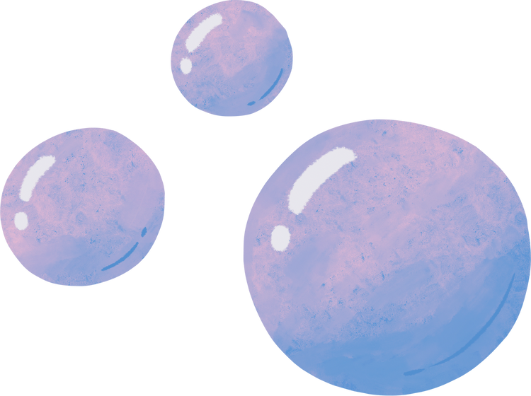

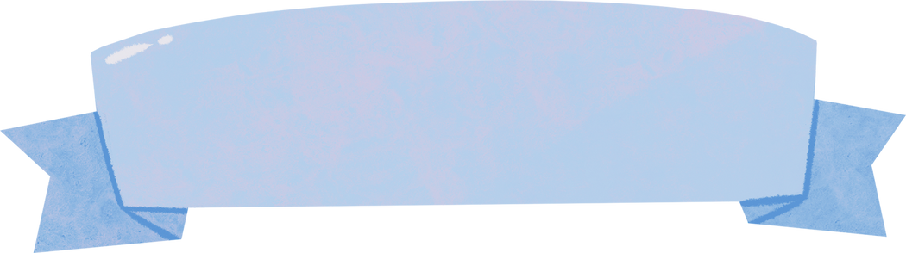


Presented by PinPin
PREDICTING WATER QUALITY
Classification

Slide 2


Background Information
This is a dataset collected from an environmental company.
The dataset contains various information on water from different sources. From the perspective of quality control, the company wants to build a machine learning model to predict water quality based on the water properties.
Classification

Slide 3


Table of Contents
1.
Dataset Exploration
2.
Dataset Processing
3.
Model Selection
4.
Model Improvement
Classification

Slide 4


1
Dataset Exploration
Classification

Slide 5

Data Dictionary
5.
Name | Data Type | Description
Quality | Categorical | Label to indicate Clean(1) or Unclean(0)
Hardness | Numeric | Total amount of Metal in sample
Solids | Numeric | Total amount of Solids in sample
Chloramines | Numeric | Total amount of Chloramine in sample
Sulfate | Numeric | Total amount of Sulfate in sample
Classification

Slide 6
Data Dictionary
6.
Name | Data Type | Description
Ph | Numeric | Label to indicate Clean(1) or Unclean(0)
Conductivity | Numeric | Total amount of Metal in sample
organic Carbon | Numeric | Total amount of Carbon in organic compounds in sample
Trihalomethanes | Numeric | Total amount of Trihalomethanes in sample
Clarity | Numeric | Distance in decimeter(dm)
Classification

Slide 7
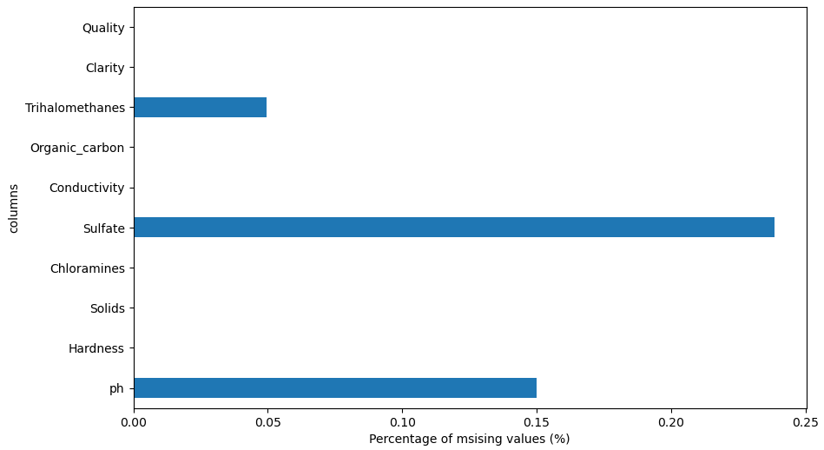

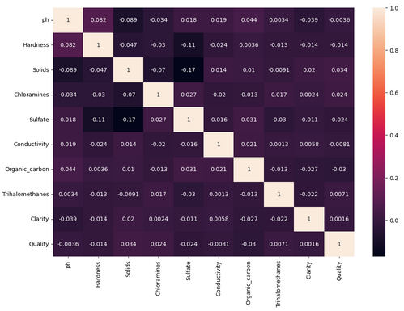
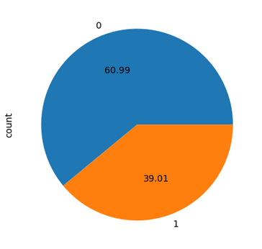
7.
Data Information
FUNCTIONS USED
water_quality.shape
water_quality.info()
water_quality.describe()
water_quality.isna().sum()
In our Dataset, we have:
A Target Variable: ("Quality") and 9 Features
Shape = (3276, 10)
categories with NA values are
ph
Sulfate
Trihalomethanes
Classification

Slide 8
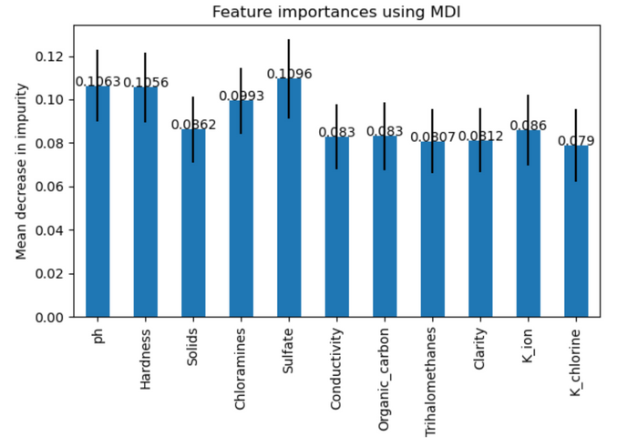


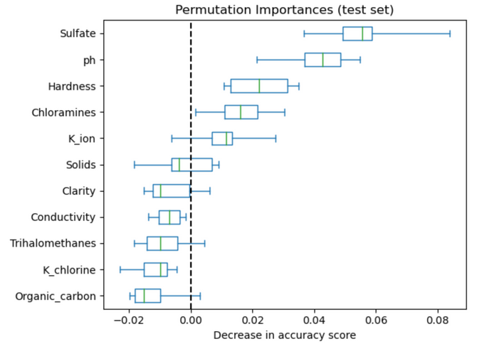
8.
Feature Engineering
New Feature
TDS(mg/L) = KE × EC(μS/cm)
Solids has a linear relationship to the Conductivity of water. Higher gradient will lead to higher ions in water which is harmful towards the human body
THM = k(pH − a)Cl2^{mtn} × TOC
Trihalomethanes has a linear relationship to the Organic Carbon in the water. Higher gradient will lead to higher concentration of toxic chlorine water in water.
Source:
https://iopscience.iop.org/article/10.1088/1755-1315/118/1/012019/pdf
https://dergipark.org.tr/tr/download/article-file/215448
Classification

Slide 9
2
Dataset Processing
Classification

Slide 10
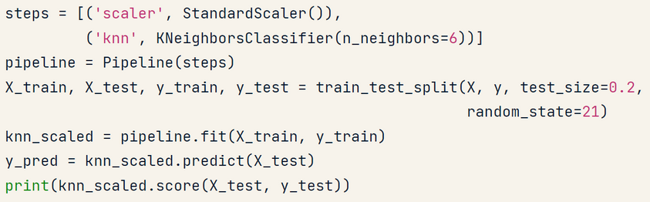
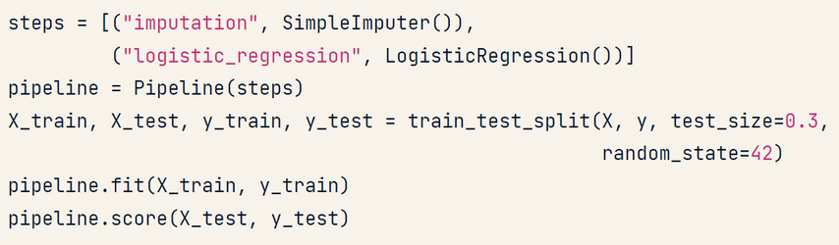
Scaling Data
Missing Data
10.
Increasing | Decreasing values
NA values
Methods
Standardization
the mean and divide by variance
features centered to 0 & variance = 1
Normalization
data ranges from -1 to +1
How to Handle:
drop df.dropna(subset=)
Imputation - replace with educated guesses
mean
median
mode
Note:
some models, scaling is IMPORTANT
but some doesn’t affect predictability
Note:
Split before imputing to prevent data leakage
Classification

Slide 11
3
Model Selection
Classification

Slide 12
Scoring Methods
12.
Accuracy
F1 Score
what is the % of correctly predicted target
Harmonic mean of precision and recall,
Balanced Accuracy
Mean of specificity and sensitivity
ROC_AUC
Recall
Area Under the Receiver Operating Characteristic Curve
True Positive Rate
Percentage that correctly identified TP and TN
Classification

Slide 13
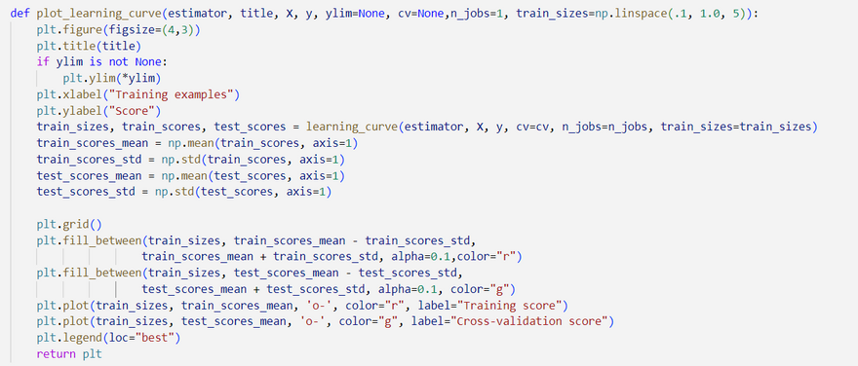
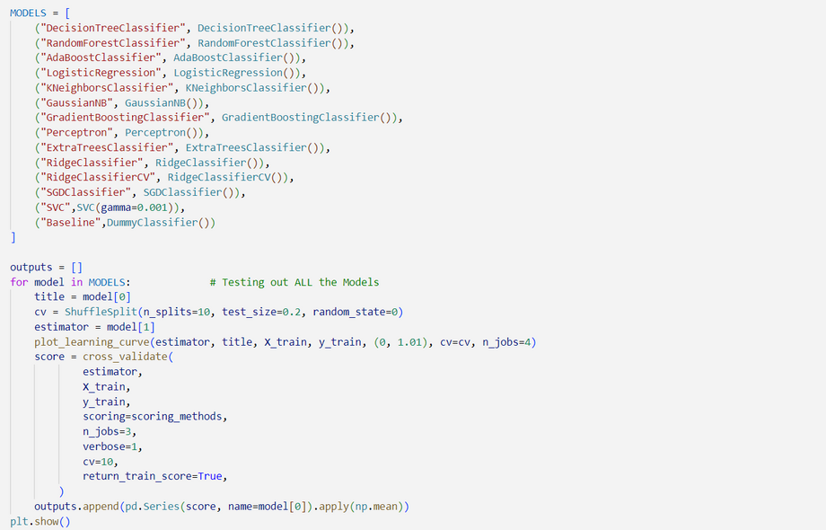
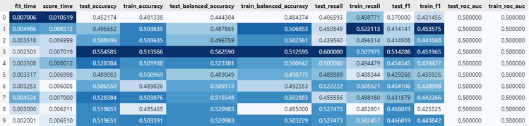
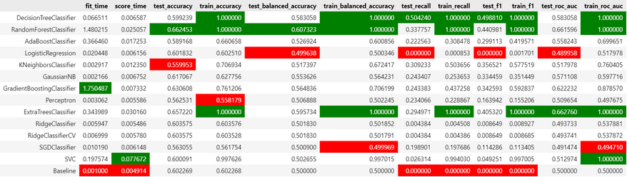
Model building
13.
Choosing Model
We Create a function to repeat the steps for all the Models
Baseline Model
Overall Model Status
GradientBoosting has the best learning curve
Classification

Slide 14
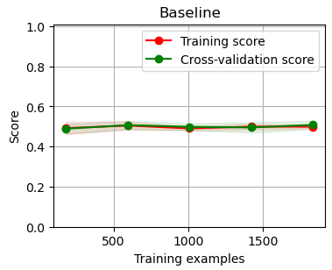
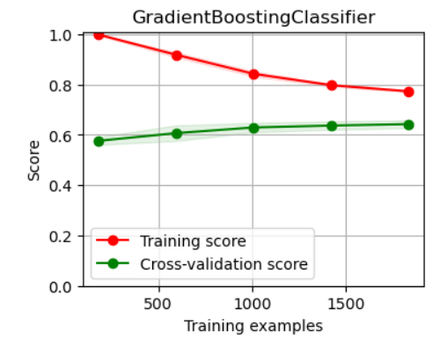
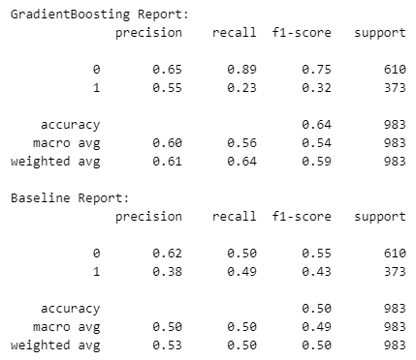
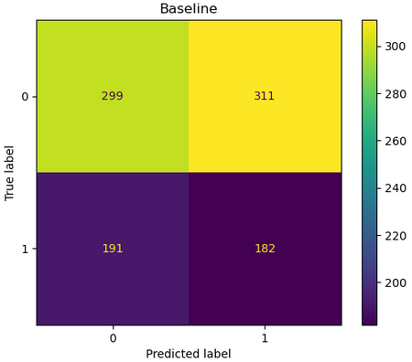
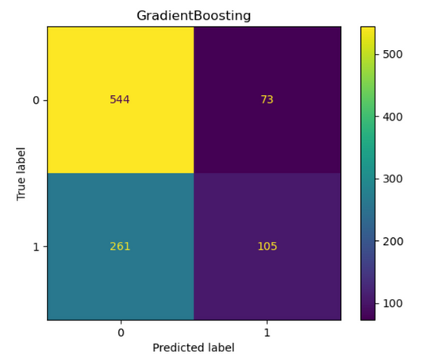
Learning Curve
Choosing Model
14.
GradientBoosting
It uses an Ensemble of weak prediction models
Confusion Matrics
Classification

Slide 15
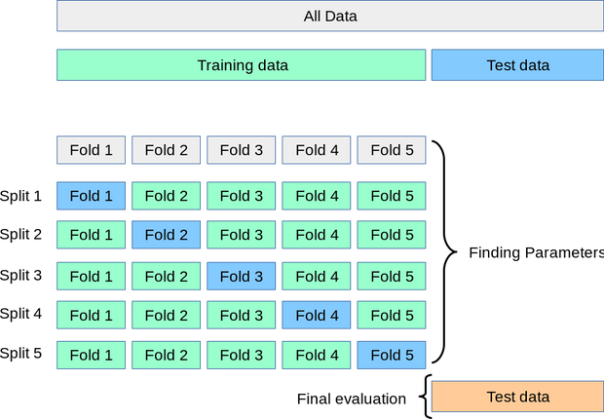
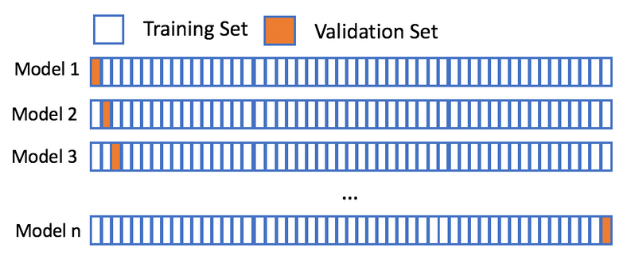
Cross Validation
15.
K-folds
Leave-one-out
splitting into k-subsets
Validate for k-times
same thing as K-folds but it splits it into 1row (test) rest (train)
Very time consuming
Classification

Slide 16
4
Model Improvement
Classification

Slide 17

17.
Ways to Improve Model
1. Hyperparameter Tuning
Tuning the default parameters of the model to best fit the data given
2. Ensemble Methods
combining multiple models instead of using a single model.
Bagging
Boosting
Stacking
Classification

Slide 18
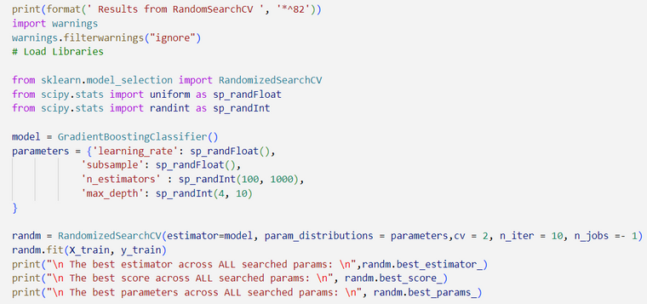
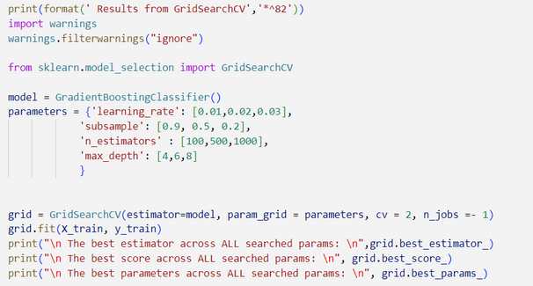
Parameter:
learning_rate
subsample
n_estimators
max_depth
Hyperparameter Tuning
18.
Changing Models Default Parameters
GridSearchCV
RandomSearchCV
A technique to search through All the parameter values from the given set of the grid of parameters
A technique to search through Random parameter values from the given set of the grid of parameters
Classification

Slide 19
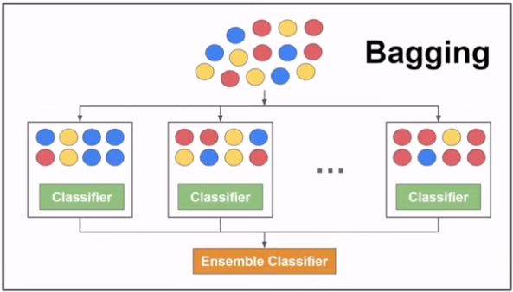
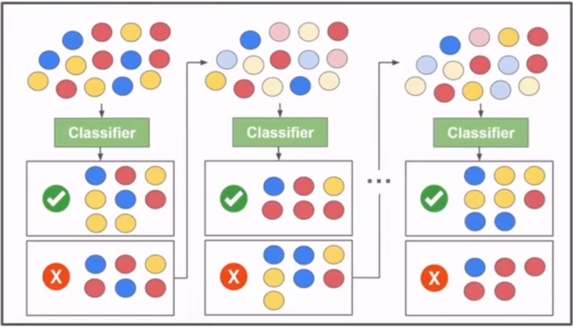
Ensemble Methods
19.
Bagging (Parallel)
Boosting (Sequential)
Decreases variance
prevent overfitting
Making a Stronger model with the wrongly predicted values
Classification
stacking
not in python

Slide 20

Summary
Dataset Exploration
Found out what data we are working with and how they related with each other (new features
Dataset Preprocessing
Imputed and scaled data so model can learn more effectively
Model Selection
Scoring methods and learning curves for all of the models (BEST = GradientBoosting)
Model Improvement
2 ways of improving
Hyperparameter Tuning
Ensemble Methods

